Slide 1
Operational Amplifier: Introduction

Slide 2
Outline
Dependent Sources
Operational Amplifier: Introduction
Op-Amp: Circuit Symbols and terminal
Op-Amp: VTC (Voltage Transfer Characteristics)
  Linear Amplification
  (Positive and Negative) Saturation
Op-Amp: Examples
Op-Amp: Physical Entity

Slide 3
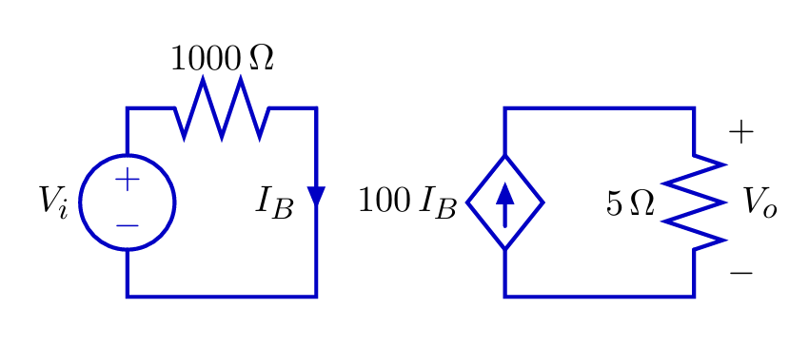
Dependent Sources
To analyze op-amps, we must understand dependent source.
A dependent source generates a voltage or current whose value depends on another voltage or current.
Example: current-controlled current source

Slide 4
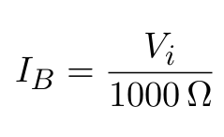
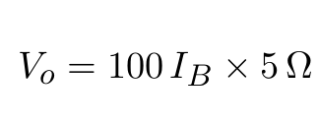
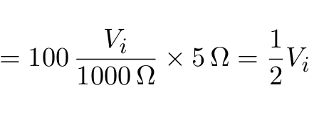
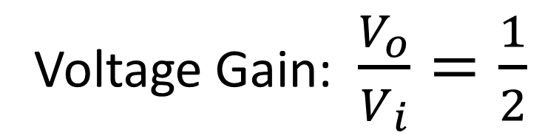
Dependent Sources

Slide 5
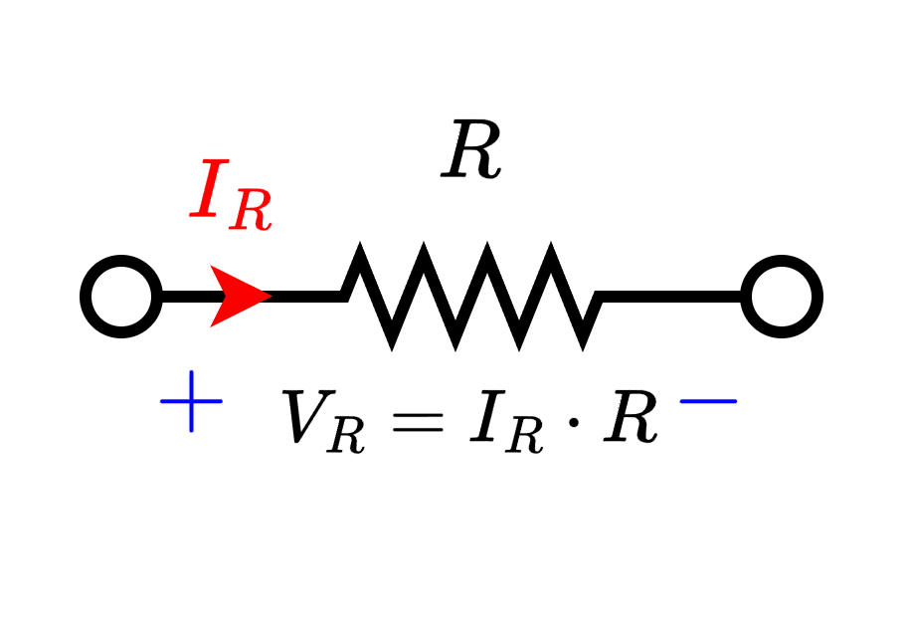
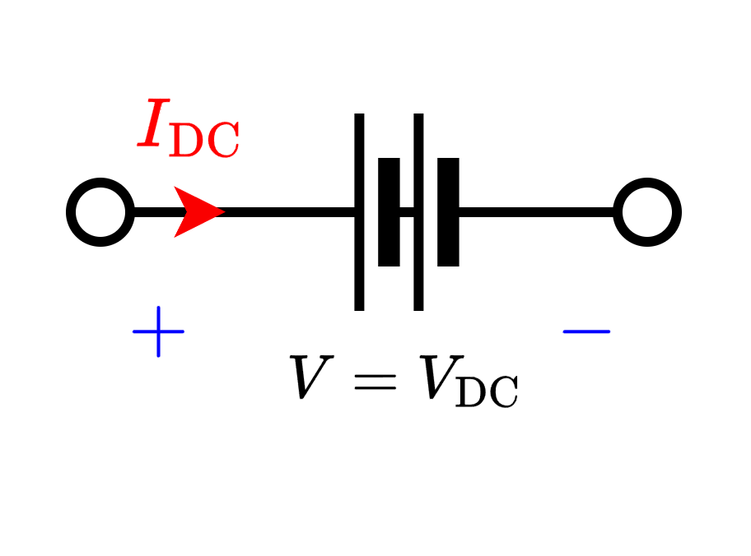
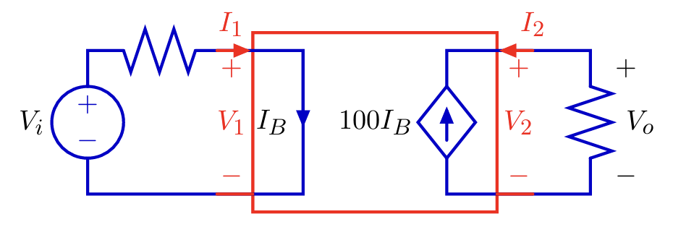
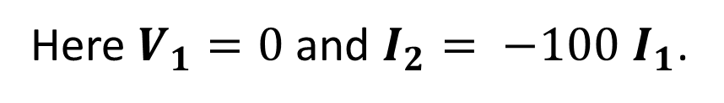
Dependent Sources
Resistors, (Ind.) Voltage sources, (Ind.) Current sources are single “port” device. They are characterized by a single equation.
Dependent sources are two-ports: characterized by two equations.

Slide 6
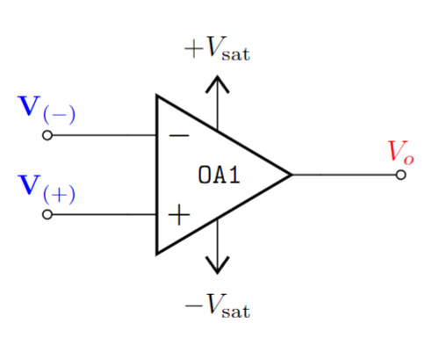
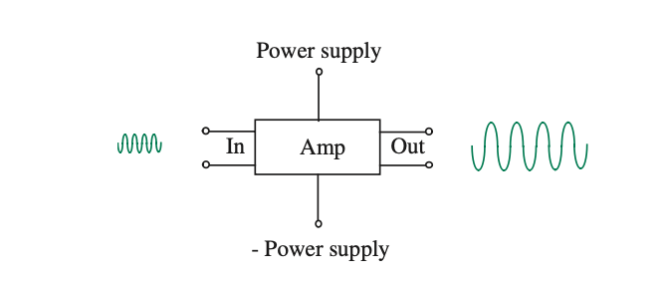
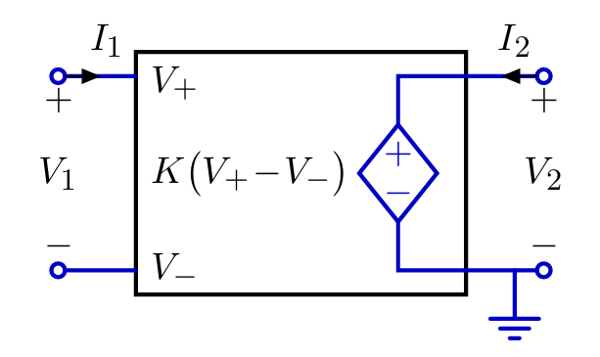


Operational Amplifier: Introduction
Operational:
Mathematical Operations
Amplifier:
Amplifies input signal/voltage.
Large Signal
Small Signal
An op-amp (operational amplifier) can be modelled by a voltage- controlled voltage source.
Small Signal
Large Signal

Slide 7


Operational Amplifier: Introduction
An op-amp (operational amplifier) can be represented by a voltage- controlled voltage source.
Small Signal
Large Signal

Slide 8
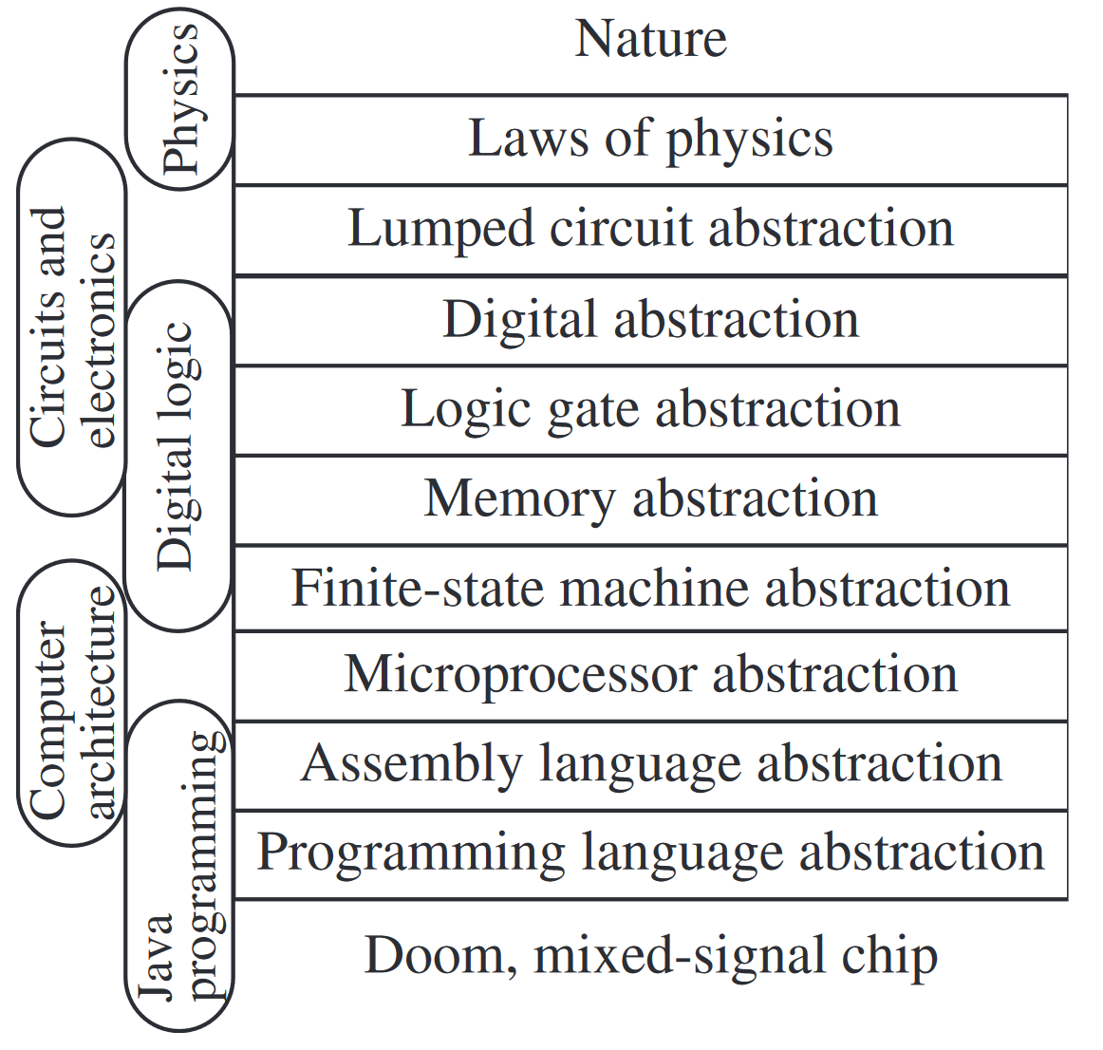
Operational Amplifier: Introduction
The Circuit Abstraction
Op-Amp
Sequence of courses and the abstraction layers

Slide 9
Op-Amp: Circuit Symbols and terminal
Positive Saturation / Supply Voltage
Inverting terminal voltage
Output Voltage
Non-inverting terminal voltage
Negative Saturation / Supply Voltage

Slide 10



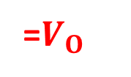

Op-Amp: Circuit Symbols and terminal
Difference Amplifier –
  Amplifies the voltage difference between two terminals.
 | Differential input voltage
Voltage Transfer Characteristics (VTC)

Slide 11
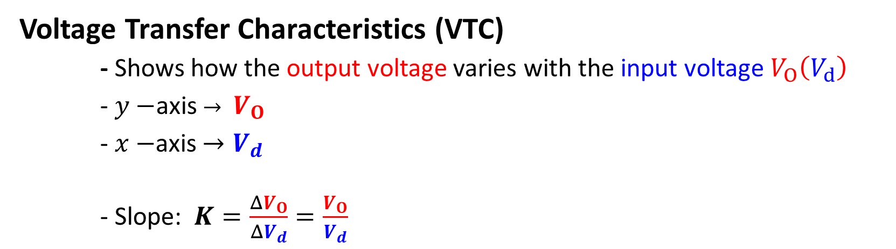





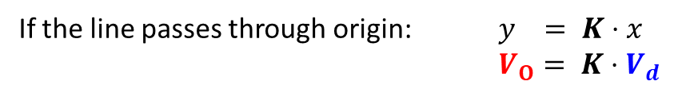
Op-Amp: VTC – Linear Amplification
15 V
1.5 V
LINEAR AMPLIFICATION

Slide 12
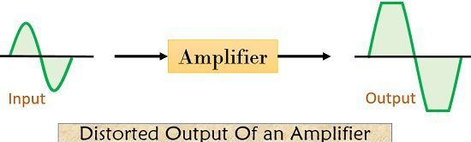
Op-Amp: VTC – Linear Amplification
Linear Amplification only takes place within a valid input range.
Otherwise output will be distorted - - Saturation
The limiting factor of linear amplification is determined by the power supply to the amplifier

Slide 13

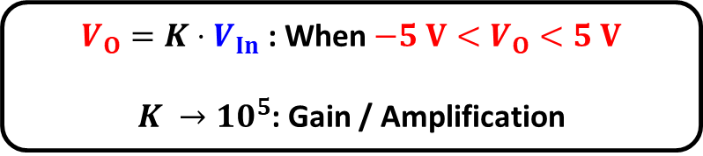


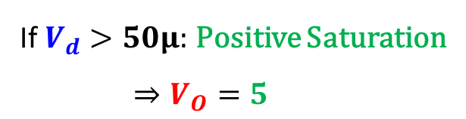

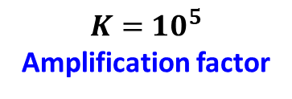



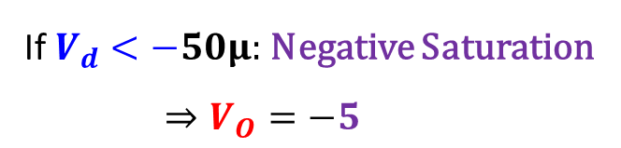

Op-Amp: VTC - Saturation
Non-Linear characteristics

Slide 14


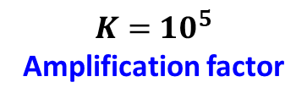
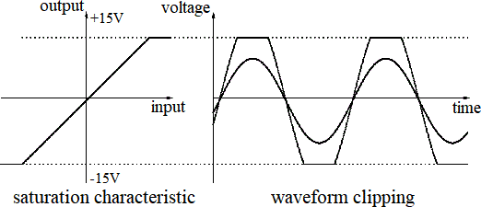




Op-Amp: VTC - Saturation

Slide 15

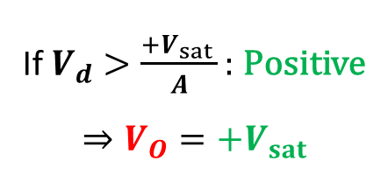


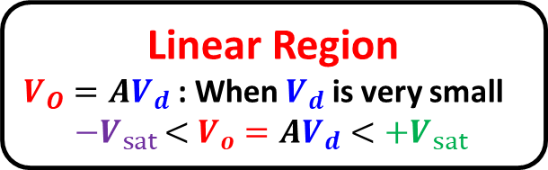




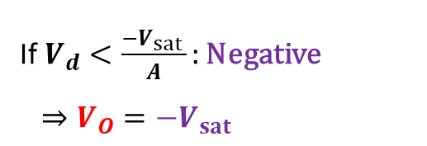

Op-Amp: VTC - Summary
Voltage Transfer Characteristics (VTC)
Positive saturation:
Output
axis
Negative saturation:
Input
axis

Slide 16

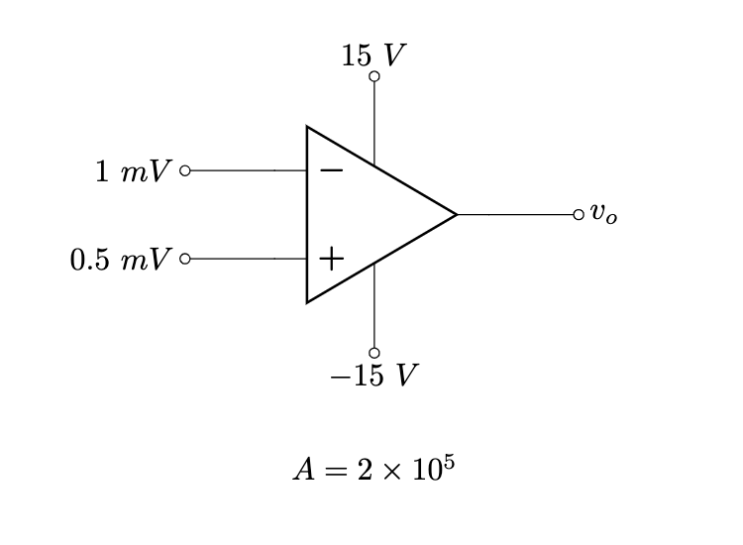
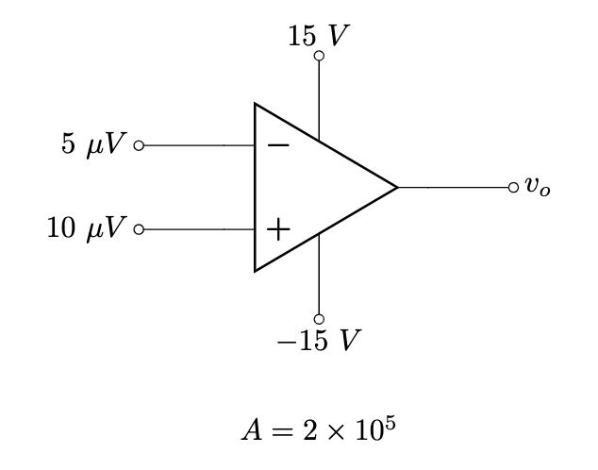
Op-Amp: Examples

Slide 17












Example 1
Solution:

Slide 18










Example 2
Solution:
(Negative saturation)

Slide 19
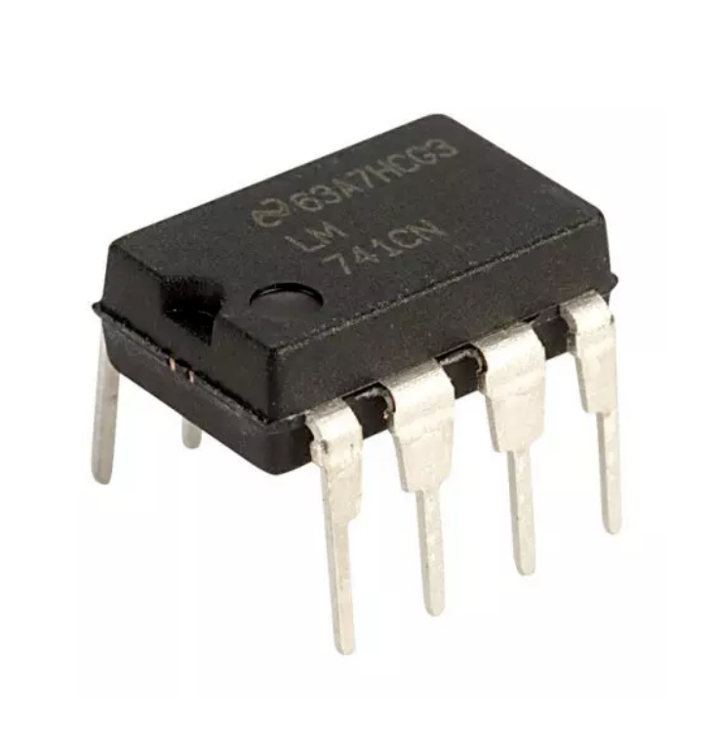
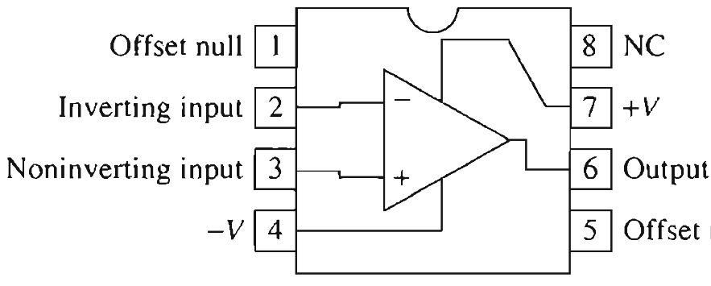
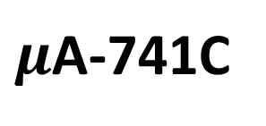
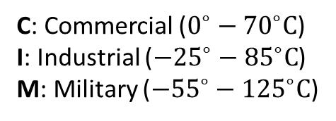
Op-Amp: Physical Entity
Difference Amplifier – Amplifies the voltage difference between two terminals.
7
NC – No Connection
2
6
3
4
Circuit symbol for the general-purpose op amp.
Pin numbering is that for an 8-pin mini-DIP package
Manufacturer ID
Part Identification Number (PIN)

Slide 20


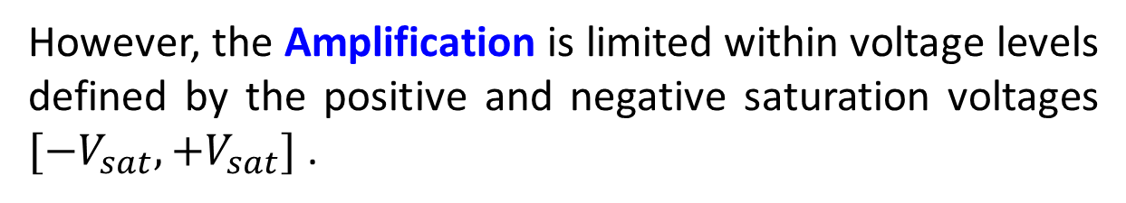




Op-Amp: Summary
The “ideal” op-amp behaves like a voltage dependent voltage source within the linear region.

Slide 21
Thank you!

Slide 22
Operational Amplifier: Open Loop Configuration

Slide 23
Outline
Operational Amplifier – Terminals and VTC (Recap)
Op-Amp: Circuit Modelling
Example Problem – Op-amp model
Op-amp configuration – open and closed loop
Open Loop op-amp: Voltage Transfer Characteristics
Open Loop op-amp: Comparators
Comparator Application
  Smoke detector
  Automatic AC switch

Slide 24
Op-Amp (Recap)
Operational:
Mathematical Operations
Amplifier:
Amplifies input signal/voltage.
Large Signal
Small Signal
An op-amp (operational amplifier) can be represented by a voltage- controlled voltage source.
Small Signal
Large Signal

Slide 25





Op-Amp: VTC (Recap)
Voltage Transfer Characteristics (VTC)
Positive saturation:
Output
axis
Negative saturation:
Input
axis

Slide 26



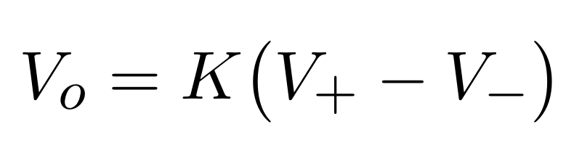


Op-Amp: Circuit Modelling
Voltage controlled voltage Source
“Ideal” op-amp approximation

Slide 27
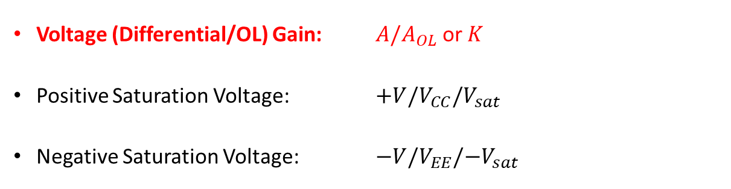





Op-amp: Circuit Model and VTC
Slope of VTC
Parameter | Typical Range | Ideally
Input
axis

Slide 28



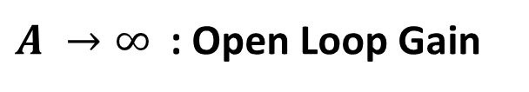
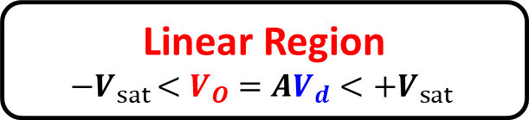

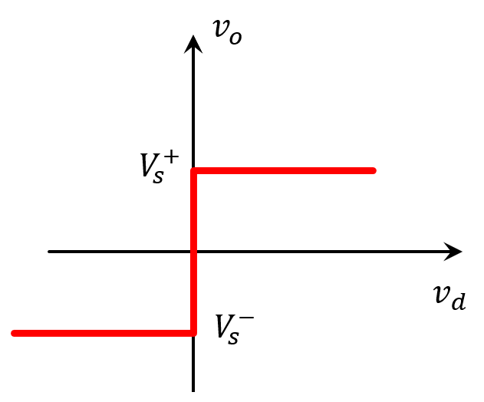






Op-amp: Circuit Model and VTC
Voltage Transfer Characteristics (VTC)
Positive saturation:
Negative saturation:

Slide 29
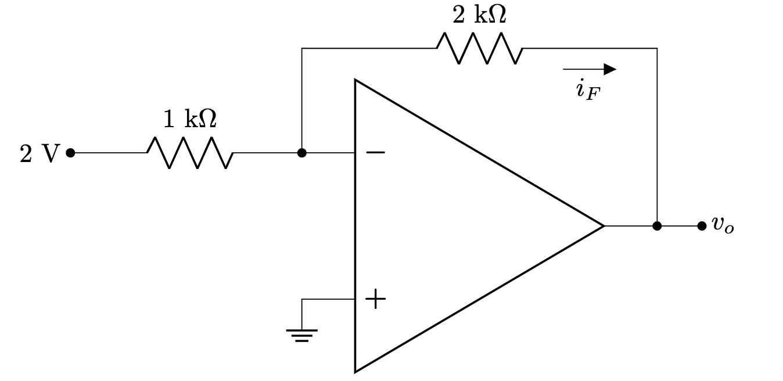
Types of Op-Amp configuration
Open loop configuration:
  No physical connection between input and output
Closed loop configuration:
  Feedback from output terminal

Slide 30
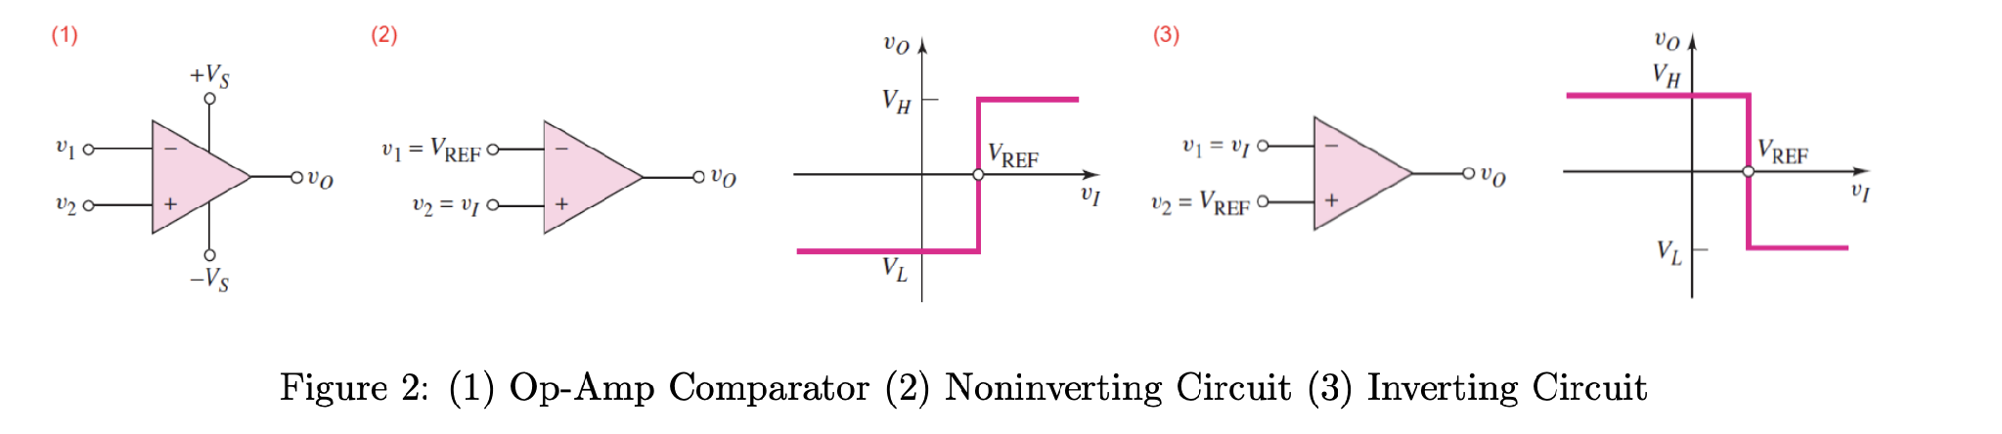


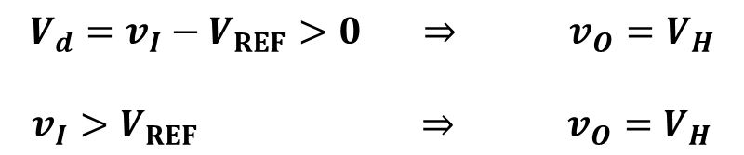
Open Loop Configuration: Comparator
Level Crossing Detector / Comparator
NON-INVERTING COMPARATOR

Slide 31


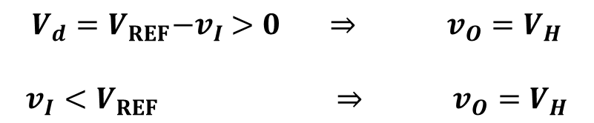
Open Loop Configuration: Comparator
Level Crossing Detector / Comparator
INVERTING COMPARATOR

Slide 32
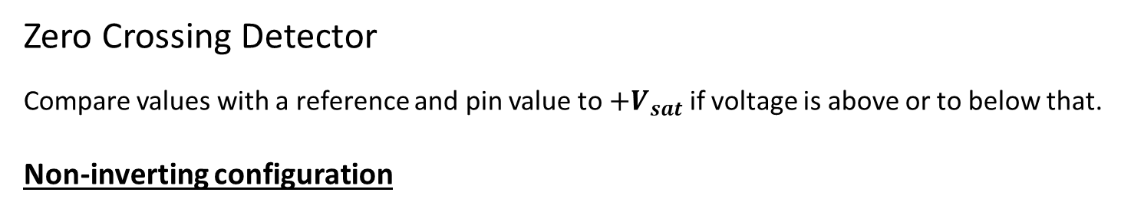
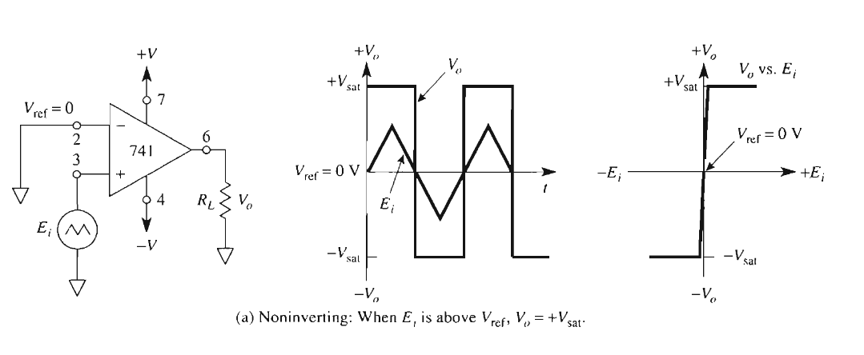
Open Loop Configuration: Comparator

Slide 33
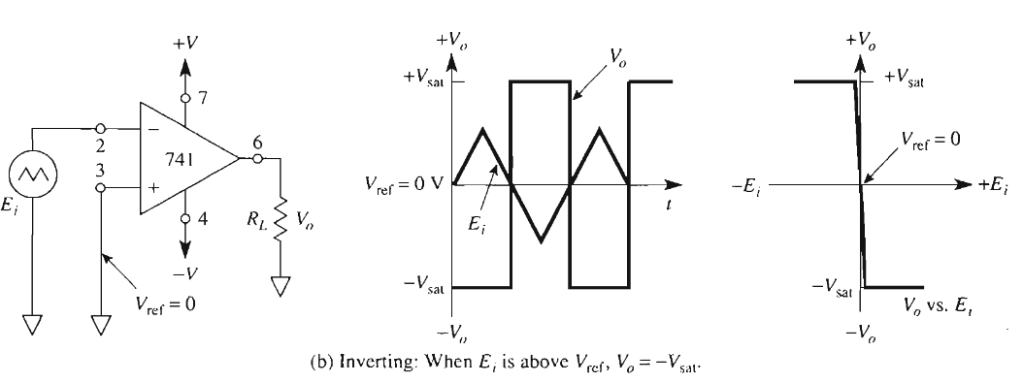
Open Loop Configuration: Comparator
Zero Crossing Detector
Inverting configuration

Slide 34
Summary
Level Crossing Detector / Comparator

Slide 35
Thank you

Slide 36
Operational Amplifier: Comparator Math

Slide 37
Outline
Op-Amp: Comparator (Recap)
Open Loop Configuration: Example 1
Open Loop Configuration: Example 2
Open Loop Configuration: Example 3

Slide 38
Op-Amp: Comparator (Recap)
Level Crossing Detector / Comparator
NON-INVERTING COMPARATOR

Slide 39
Op-Amp: Comparator (Recap)
Level Crossing Detector / Comparator
INVERTING COMPARATOR

Slide 40
Op-Amp: Comparator (Recap)
Level Crossing Detector / Comparator

Slide 41
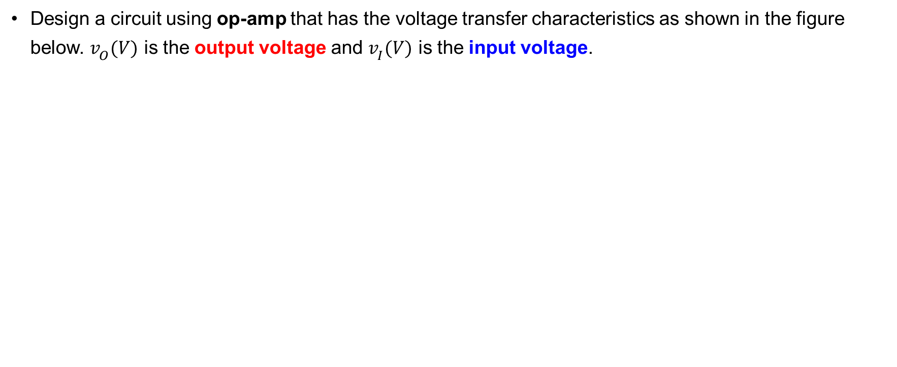
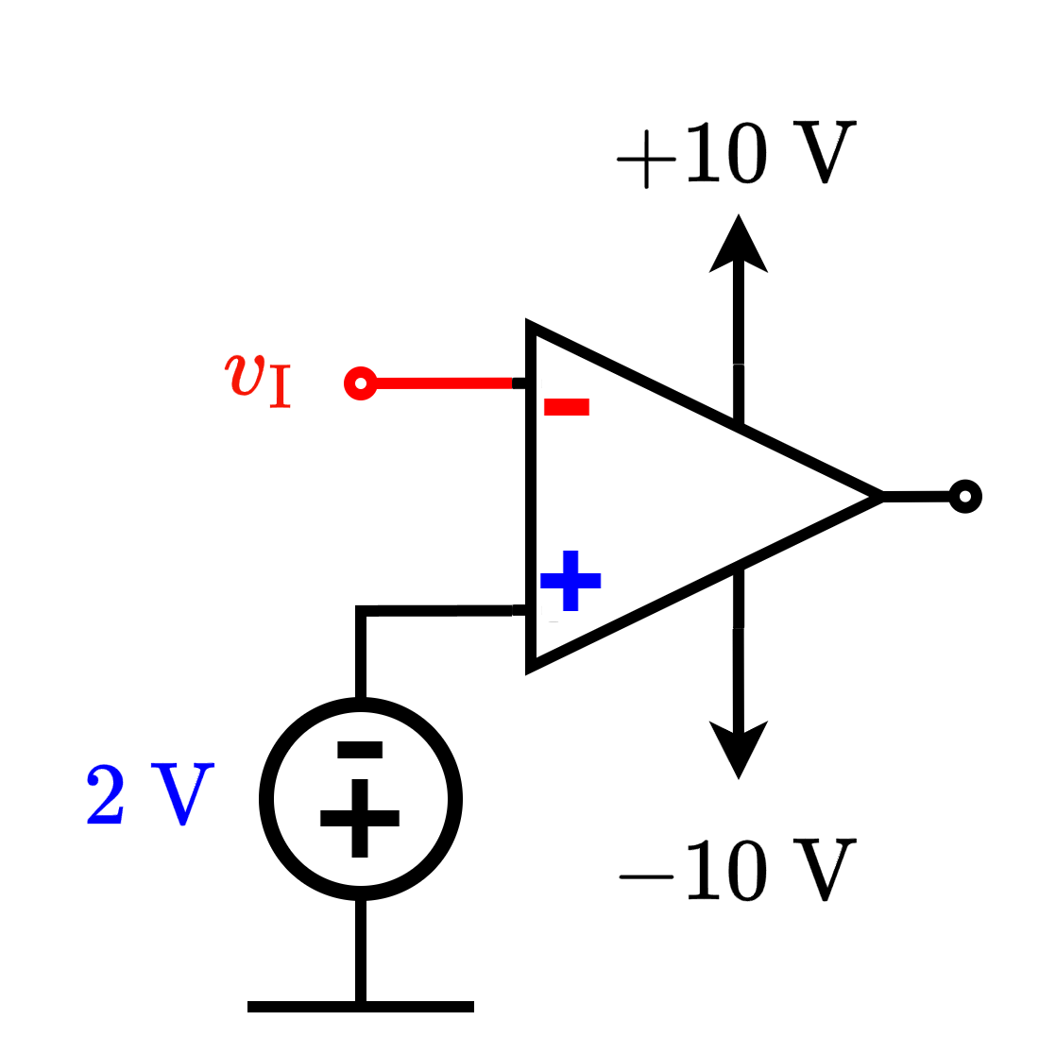
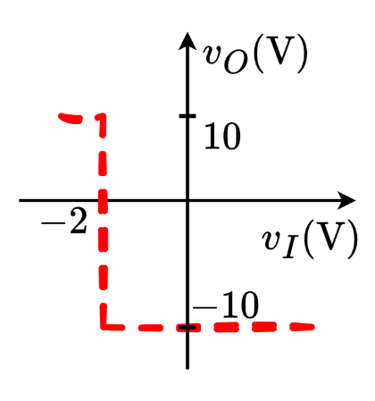
Open Loop Configuration: Example 1
Solution:

Slide 42
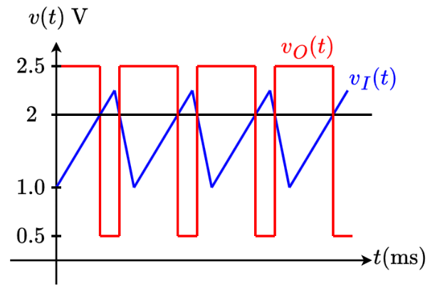
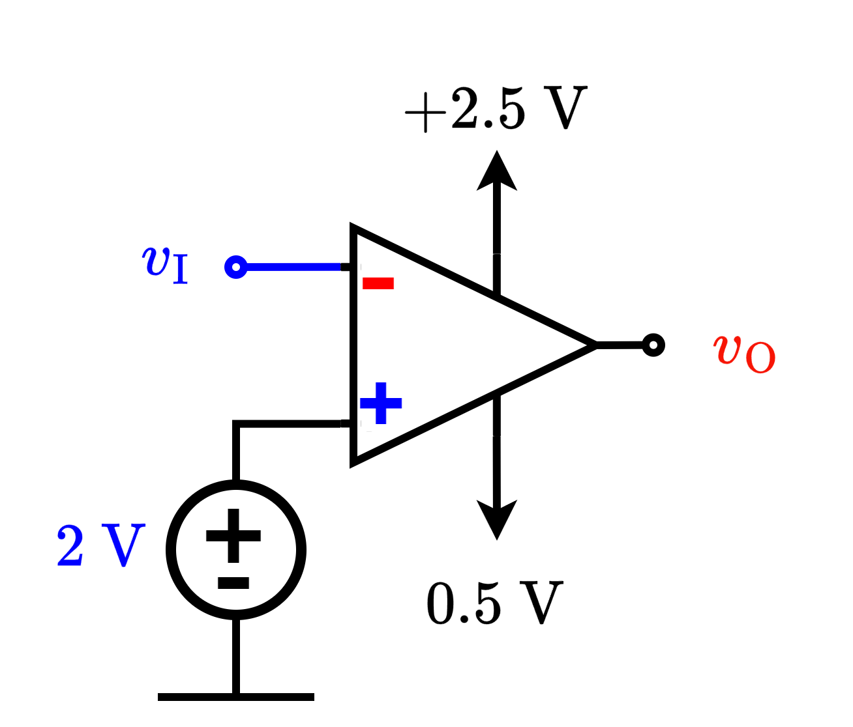
Open Loop Configuration: Example 2
Solution:
INVERTING CONFIGURATION

Slide 43










Open Loop Configuration: Example 3

Slide 44

Open Loop Configuration: Example 3

Slide 45


Open Loop Configuration: Example 3

Slide 46
Thank you

Slide 47
Operational Amplifier: Comparator Application

Slide 48
Outline
Op-Amp: Comparator (Recap)
Comparator Application - Smoke Detectors
Smoke Detector – Operation
Comparator Application – Automatic AC
General Principle - Comparator

Slide 49
Op-Amp: Comparator (Recap)
Level Crossing Detector / Comparator
NON-INVERTING COMPARATOR

Slide 50
Op-Amp: Comparator (Recap)
Level Crossing Detector / Comparator
INVERTING COMPARATOR

Slide 51



Comparator Application - Smoke Detectors
Since the alarm is an electrically driven device, we need some method to convert smoke levels to proportionate voltage.

Slide 52


Comparator Application - Smoke Detectors
LED Circuit
Voltage Divider
Op-Amp comparator

Slide 53




Smoke Detector - Operation
Light from the LED is reflected off the smoke particles on to the photoconductor –
Light Dependent Resistor (LDR).
Voltage Divider
LDR @
Light is lost in the environment
LED Circuit

Slide 54



Smoke Detector - Operation
Voltage Divider
LDR @
Light is lost in the environment

Slide 55




Smoke Detector - Operation
Voltage Divider

Slide 56



Smoke Detector - Operation
Non-inverting Op-Amp comparator

Slide 57




Smoke Detector - Operation
Non-inverting Op-Amp comparator
LED Circuit
Voltage Divider

Slide 58
Smoke Detector - Operation
Non-inverting Op-Amp comparator
LED Circuit
Voltage Divider

Slide 59



Comparator Application – Automatic AC
Sensitivity control
AC
Temperature Sensor
Temperature

Slide 60

Summary
Sensitivity control
Any Device
Physical Quantity
Sensor

Slide 61
Thank you

